Slide 1


Slide 3


Slide 4
Overview of data
Process
KPIs
Insights
Dashboard
Conclusion

Slide 5


Slide 6
USA Loan Database
37264 Records
Total 34 Columns
2 Files
Customer – ID, State, Loan Amount, Grade, Interest Rate, etc

Slide 8
Data Understanding
Data Cleaning
Data Modelling
Data Analysis
Insights

Slide 10
Year wise Loan Amount Status
Grade and Sub-Grade wise Revolve Balance
Total Payment for Verified Status vs Total Payment for Non-Verified Status
State wise and Last Credit Pull Date wise Loan Status
Home Ownership vs Last Payment Date Statistic

Slide 12
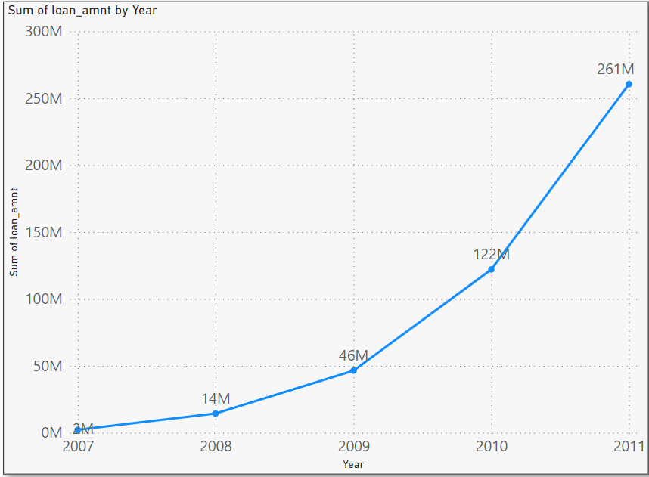
Insights
This KPI’s provides information about the distribution of total loan amounts across different years
Business Decision
Marketing and loan offer to customers from years with high loan amounts. Develop specialized loan products, engage customers, and adjust strategies based on seasonal trends for effective targeting and business growth.

Slide 14
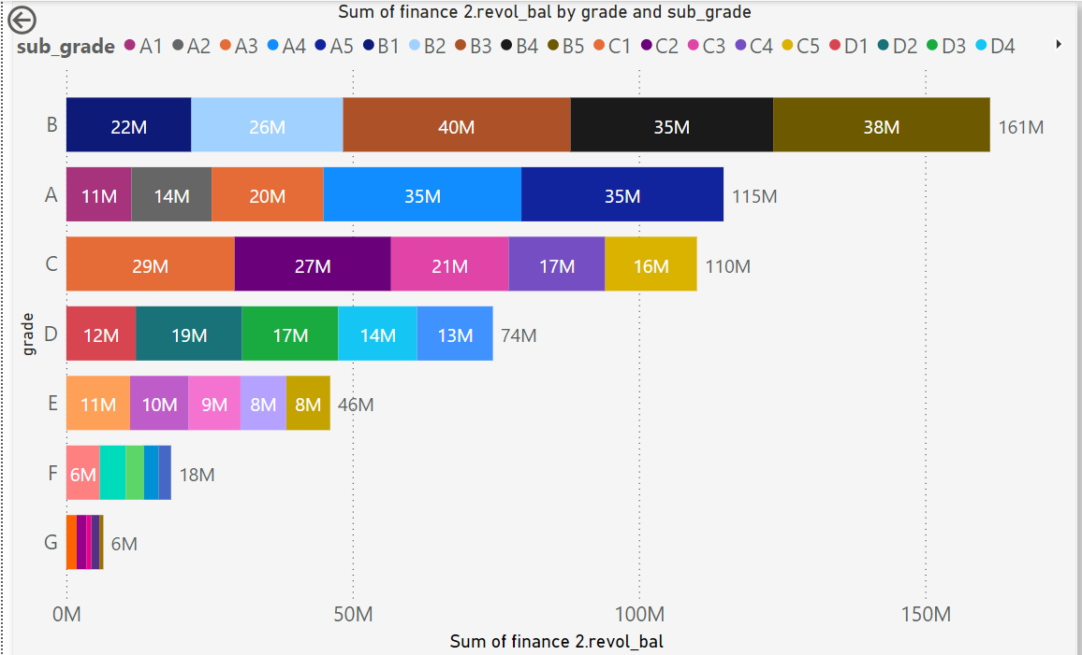
Insights
It summarizes revolving balances by loan grades and sub-grades, showing how balances are distributed within each category.
Business Decision
Leverage this data to optimize risk assessment and customer engagement
Risk Management: Tailor risk evaluation based on revolving balances in different grade/sub-grade segments.
Customer Support: Engage customers with high revolving balances, providing guidance and personalized solutions.

Slide 16
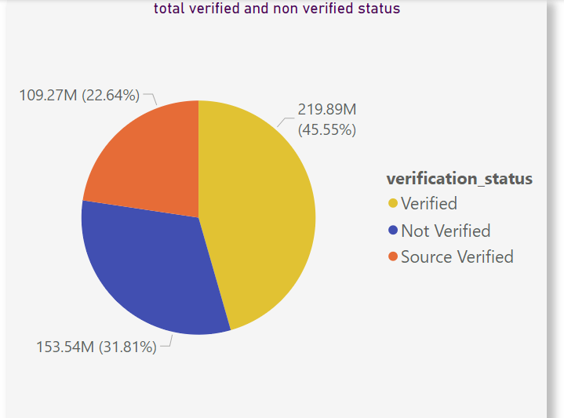
Insights
It compares total payments between "Verified" and "Not Verified" statuses, offering insight into payment behavior based on verification status.
Business Decision
Analyze, if verification status influences payment behavior. Verification processes, communication, risk assessment, and product offerings accordingly for enhanced customer engagement and risk management.

Slide 18
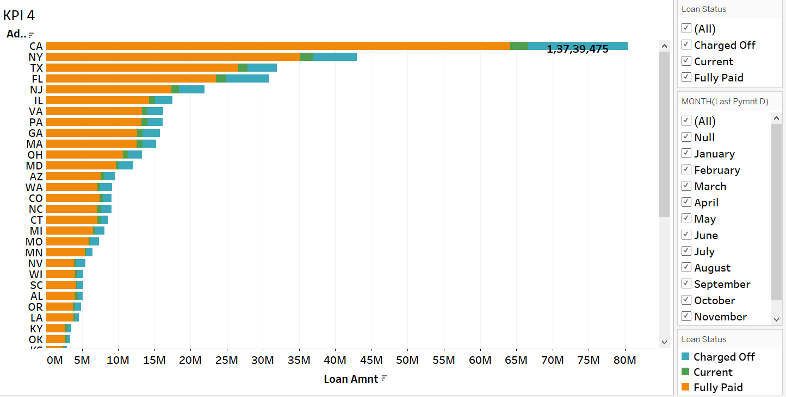
Insights
It shows loan status by state and last credit pull date, revealing regional loan performance patterns.
Business Decision
Analyze regional loan statuses. Customer outreach and resource allocation strategies based on state-specific trends to optimize operational efficiency and customer satisfaction.

Slide 20
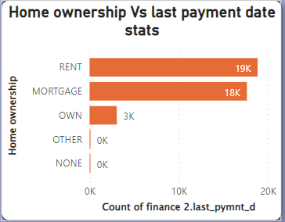
Insights
It explores payment patterns based on home ownership status and last payment dates.
Business Decision
Analyze payment behavior by home ownership to communication, assess risk accurately, offer financial education, and customize products. Develop strategies for customer retention.

Slide 21
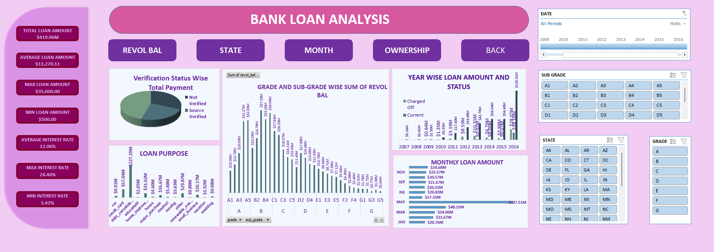

Slide 22
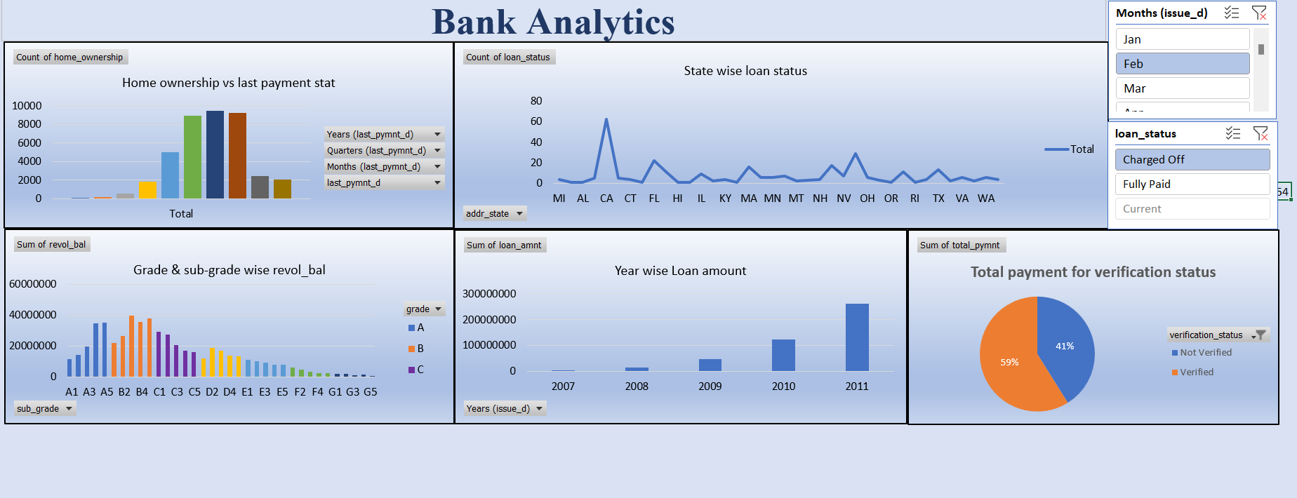

Slide 23
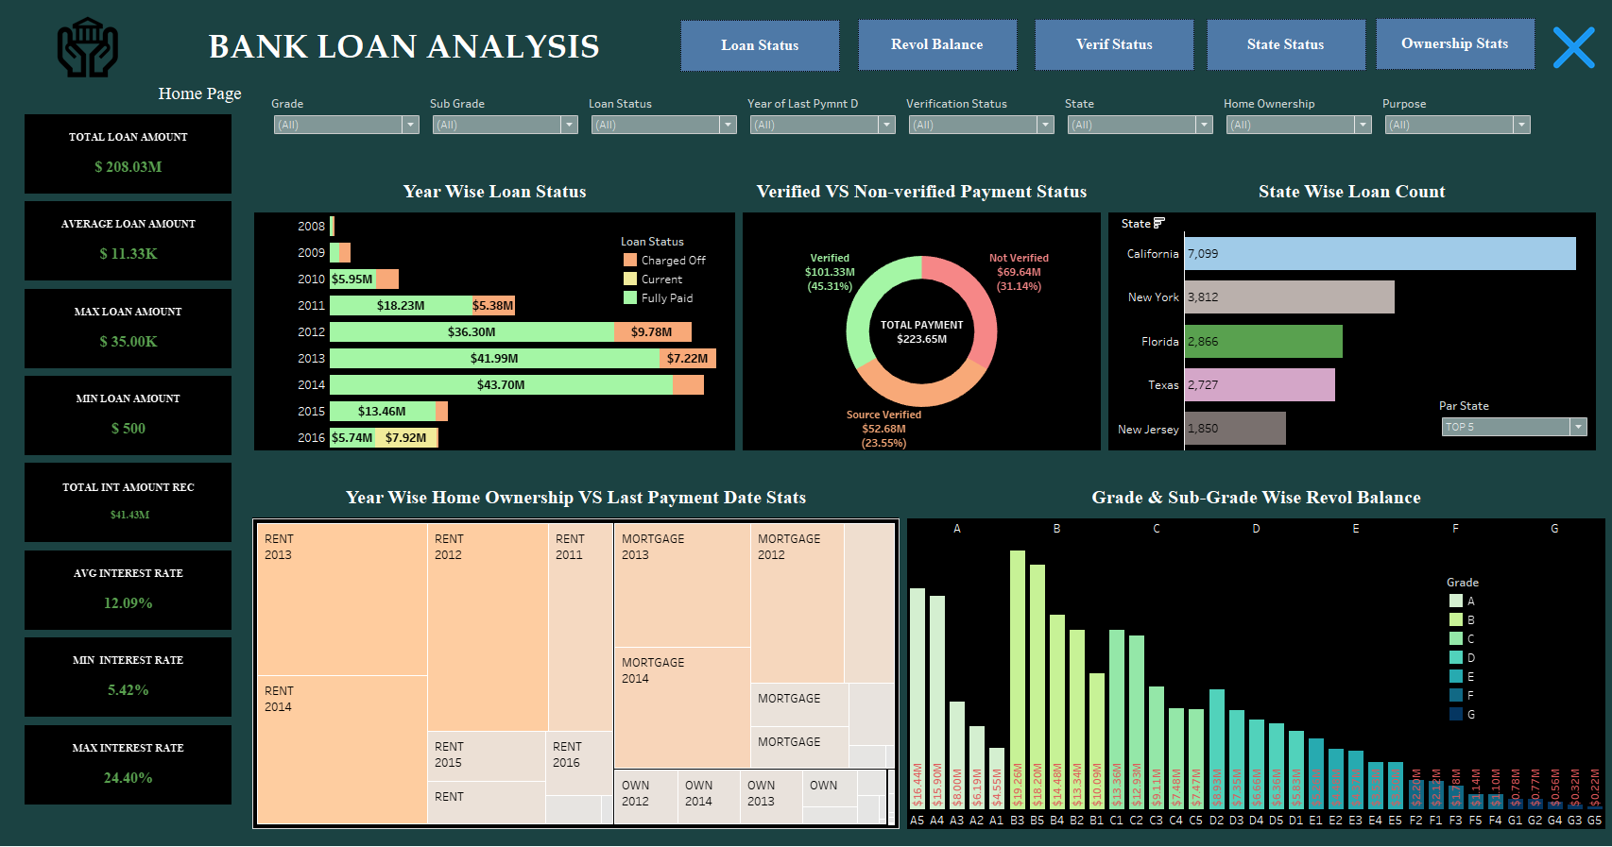

Slide 24
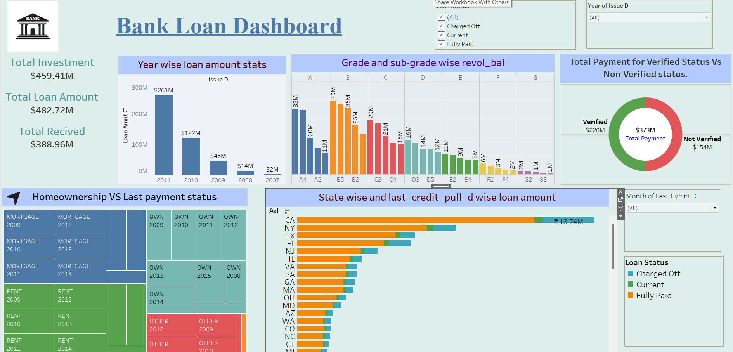

Slide 25
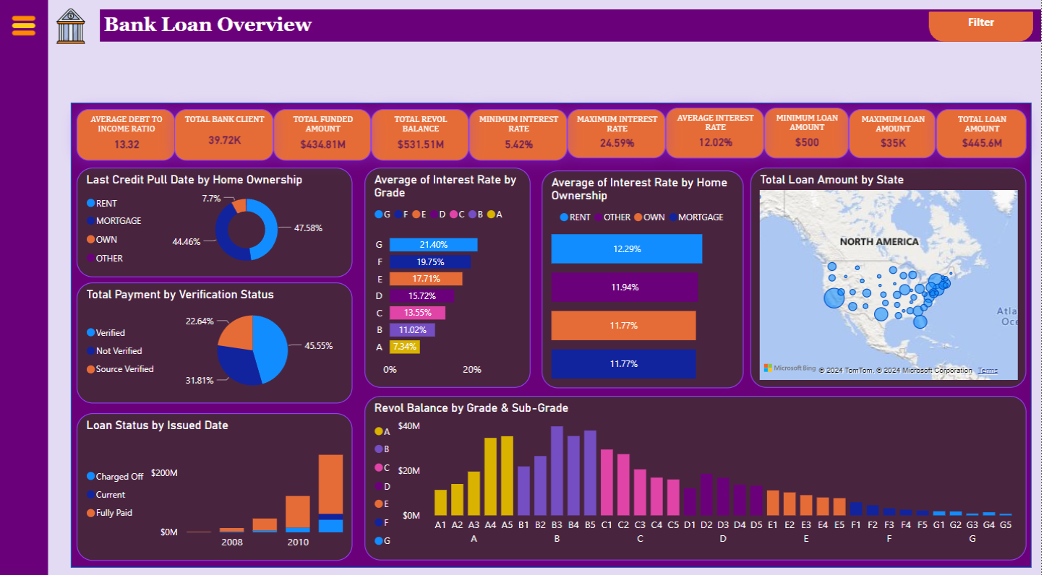

Slide 26
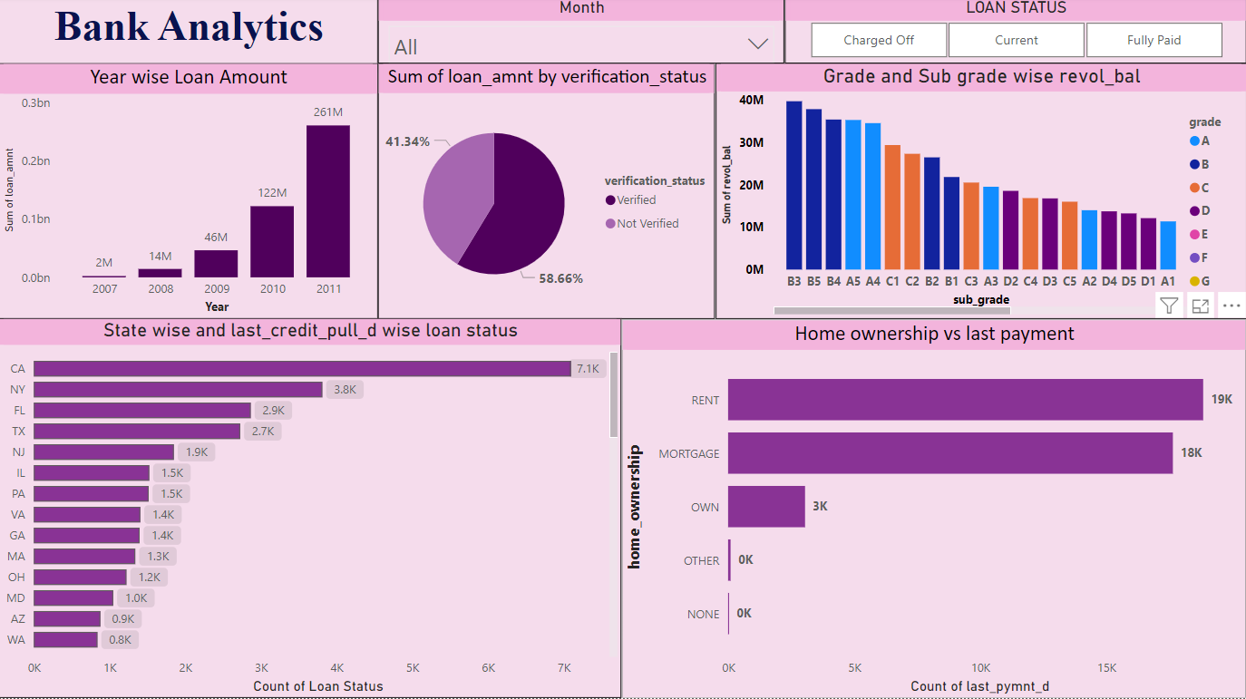

Slide 28
From the analysis of above dashboards and reports, we can draw hidden insights.
With the use of gained insights from the given KPI’s of finance dataset:
Accurate business decisions are made.
Used to track the business progress.

